Slide 1
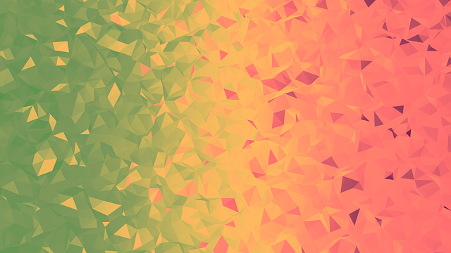
HELP
INSTRUCTIONS
What is the goal of the game? The goal is to score points by having the snake eat magic berries while avoiding losing the snake's life. The higher the level you are playing on, the more points you score.
What kills my snake? When is the game over? Your snake dies if its head collides with its body, or collides with the wall. After a collision the game is over.

